Slide 1
Translator
Development
Tuan , Severino Flórez and Ernesto Ibáñez
Software Engineering Project

Slide 2
PROJECT OBJECTIVES
Developing an app via react
Enable the user to upload pdf documents
Translate the documents

Slide 3
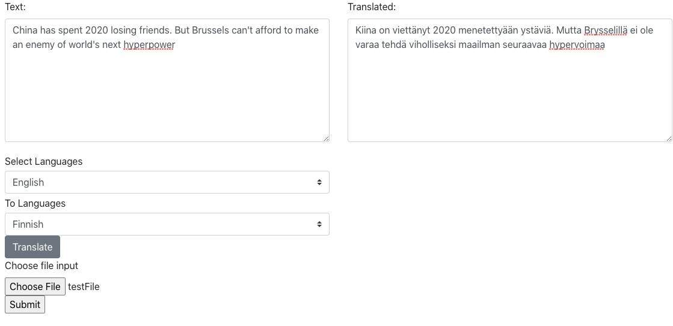
Application features
Two list buttons:
Select the original languaje
Select the final languaje
Three buttons:
Translate into the selected languaje
Upoald a file
Convert pdf into text

